Slide 1
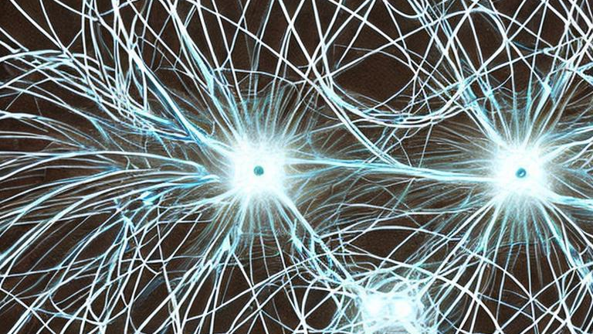

Quantum Programs and Computers
@HectorDMenendez
Hector D. Menendez

Slide 2
Programs
A program is a set of instructions for a computer.
CPU programs normally have an input/output.
They work with bits/bytes.
They tend to have a deterministic output for each input.

Slide 3
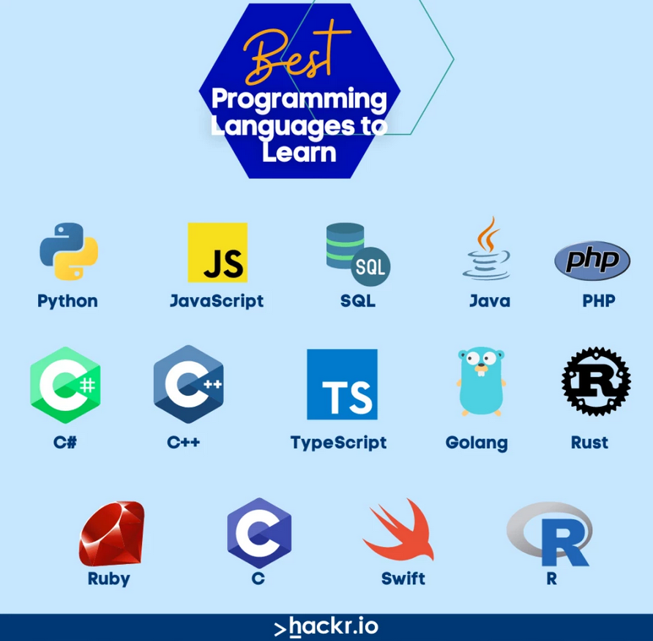
Programming Languages

Slide 4
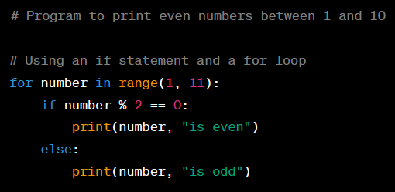
Example of a program
Variables
Comments
Conditions
Loops
Outputs

Slide 5
The concept of bits
Computers work with bits.
Every instruction and variable is translated to a series of bits.
Each bit is either 1 or 0.

Slide 6
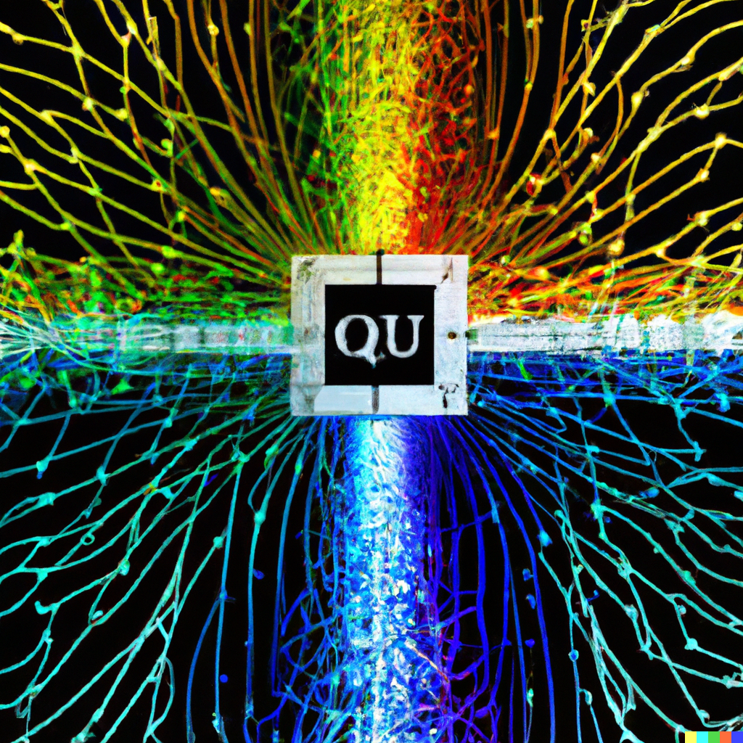
Quantum Computers
Quantum computers change the computing paradigm from bits to quantum bits or qubits.
Quantum programs can be modelled as quantum circuits, which are similar to logical circuits.

Slide 7
Qubits
Qubits are like bit, but they have a specific probability of being at each state. They are represented as:
|ψ⟩ = α|0⟩ + β|1⟩,
where |α|^2 + |β|^2 = 1 (they define a probability distribution).

Slide 8
Two New Features
Entanglement: two or more qubits can be entangled to be in the same state.
Superposition: qubits can exist in multiple states simultaneously.

Slide 9
The quantum paradigm
For each program input, we will have a probability distribution of outputs.
These outputs will be sampled by measuring.
However, in real quantum computers there is also noise.

Slide 10
Current Quantum Computers
Current computers are NISQ (Noisy Intermediate Scale Quantum).
Errors/decoherence are an issue with current quantum computers.

Slide 11

The calibration Problem
Quantum computers with superconducting Transmon qubits, based on Josephson Junction, are sensitive to noise.
Qubits are entangled with coupling resonators, which produces significant noise for gates with 2 or more qubits.
The readout operators for the resonators increase the error rate.

Slide 12
Quantum Programming Languages
Qiskit
Cirq
Q#
Bracket
Pyquil

Slide 13
An Example of a Quantum Program
We will start with qubits
We will apply different quantum gates to the qubits.
We will connect the qubits to normal bits
The bits will have measurements of the qubits,

Slide 14
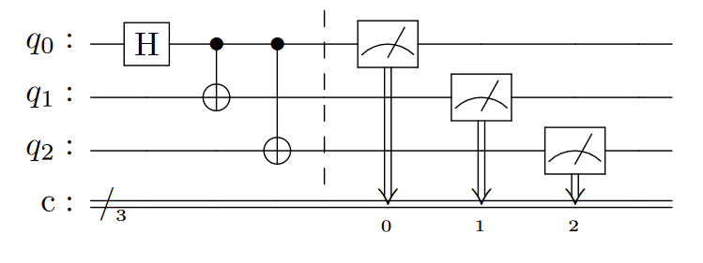
Motivating Example GHZ state
Gates
Measurements
Qubits
Bits

Slide 15
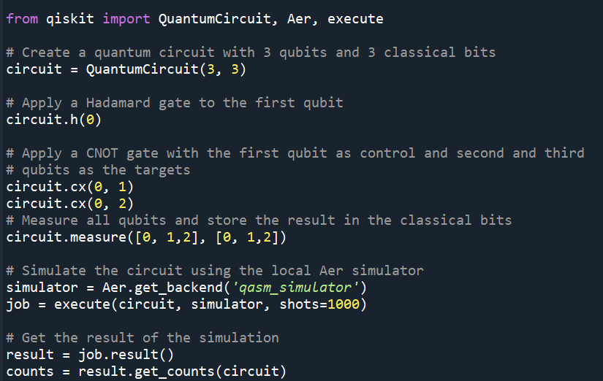
The code

Slide 16
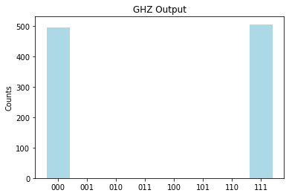
The simulated output

Slide 17
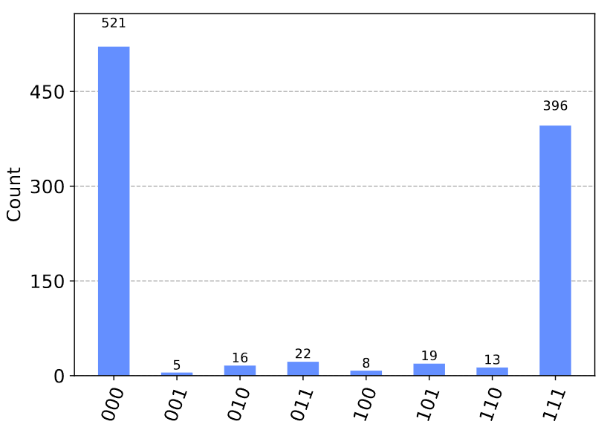
An output of a quantum computer

Slide 18
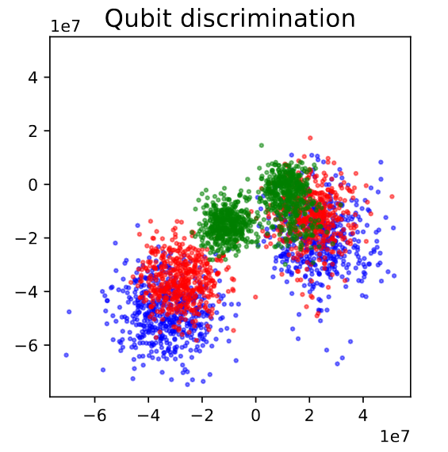
The Qubit Energy Levels

Slide 19
Open Problems
Making real quantum computers reliable
1
Testing quantum circuits
2
Finding more applications to quantum computing
3
Democratising quantum computers
4

Slide 20
To start the Challenge
Infrastructure:
https://github.com/hdg7/ssbse2024
Tutorials:
https://github.com/Qiskit/qiskit-tutorials/

Slide 21

Thanks you
@HectorDMenendez

